Slide 1
Vaccination Rates Remain Short of Goal for Staff
Service Area | % of Staff Fully Vaccinated | % of Residents Fully Vaccinated | National Goal %
Care Center | 61% | 87% | 75%
Assisted Living | 55% | 90% | 75%
Data as of May 19
Providers with 70% of staff and resident having two doses are now maintenance mode and only report once a month (33% of providers currently on maintenance mode)
Source: MDH

Slide 2
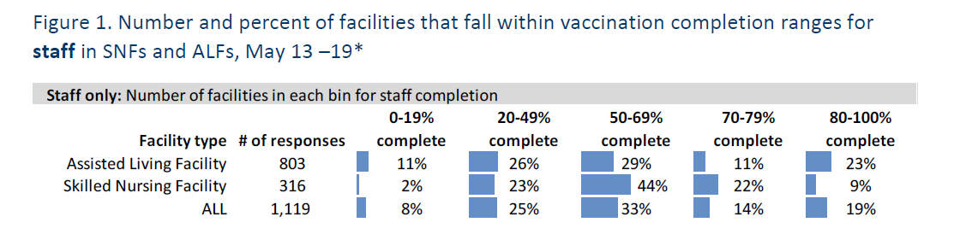
Staff Vaccination Rates Vary Substantially by Provider
Data as of May 19
MDH Reaching out to those in the lowest tiers to work on improvement strategies
Source: MDH

Slide 3
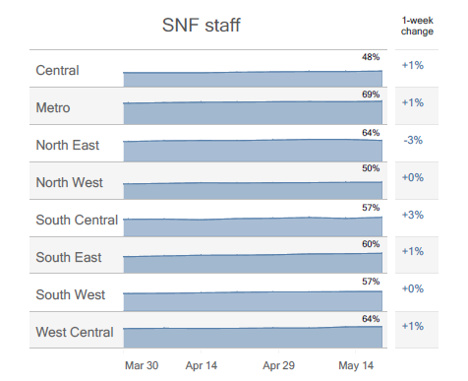
Staff Vaccination Rates Vary Substantially by Location (full vaccination rates)
Data as of May 19
AL Staff Data Shows Similar Pattern
Source: MDH

Slide 4
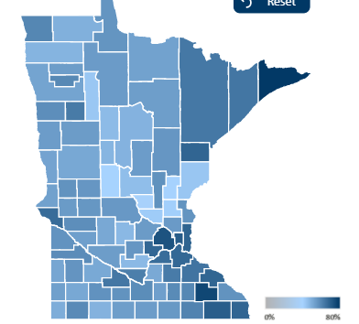
General Population (16+) Vaccination Rates Vary Substantially by County
Data as of May 21
63% statewide have received at least one dose
Lowest County is Benton at 38%, highest is Cook at 80%
Source: MDH

Slide 5
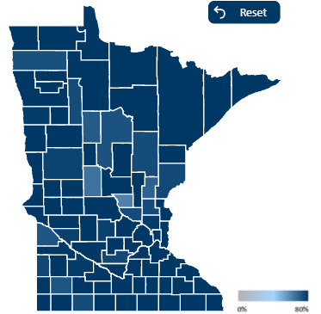
Older Adult (65+) Vaccination Rates Very High Statewide
Data as of May 21
89% statewide have received at least one dose
Lowest County is Benton at 61%
Source: MDH

